Slide 1
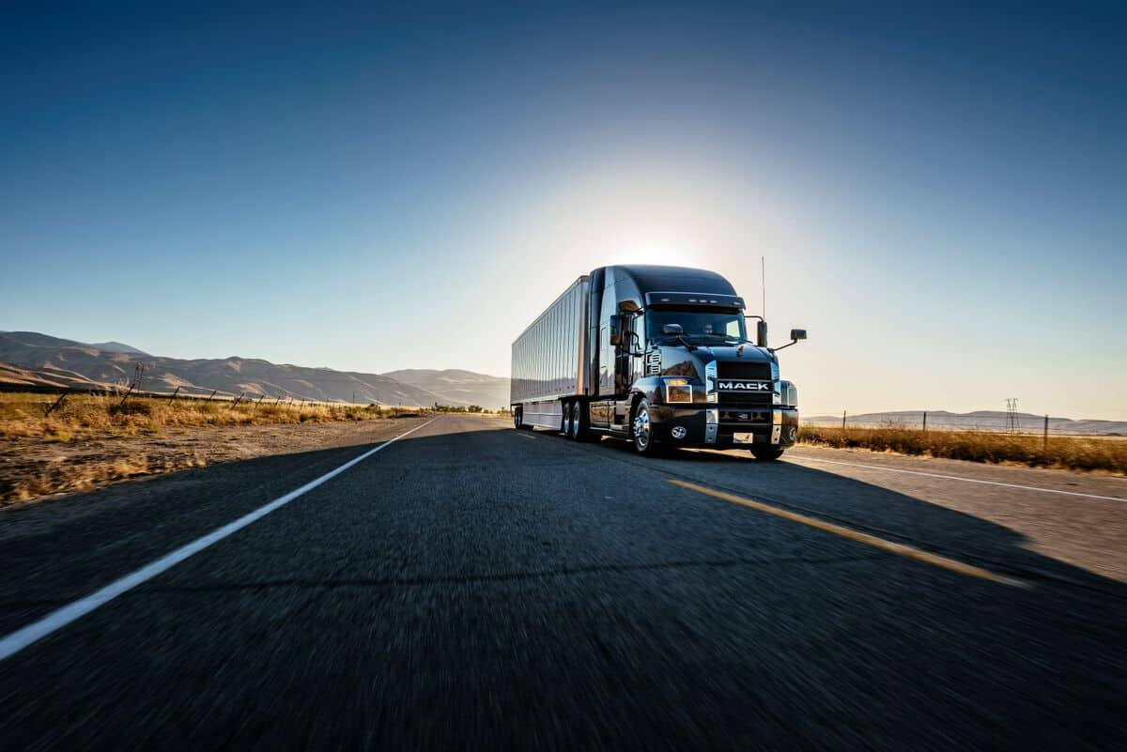
Husky Hackathon ‘22
Smart Drive ⁺
Reimagining Adaptive Cruise Control
TEAM 1
1

Slide 2





Introducing the team
Jared Lim
Informatics
Undergrad 2023
Siddharth Kadandale
FTMBA 2023
Van Mai
FTMBA 2023
Alexandra Orlova
EVEMBA 2022
2

Slide 3

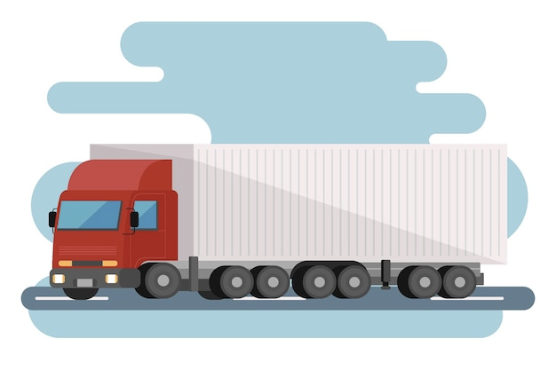


Logistics and 3PL are the backbone of the economy
….In the US alone
10+ billion tons of freight
40+ million trucks
300+ billion miles covered
~50 billion gallons of fuel
Source: American Trucking Association
3

Slide 4
What are we solving?
Freight activity will nearly double by 2040, and global freight transport emissions will exceed passenger vehicle emissions by 2050
Improving fuel efficiency is key!!
We aim to leverage a Software-first approach
For the logistic freight carriers
In order to:
Reduce fuel consumption & carbon emissions
Improve profit margins for carriers
Enhance vehicle safety
4

Slide 5



Smart Drive +
Next gen-vehicle architecture
Over the Air Capability
Cloud
Communication
AI-enabled algorithm
Smart Drive + Optimization Engine
Smart Drive +
Cloud Orchestrator
Campaign Manager (Scheduler, Policies, Delivery)
Package Manager (Encryption, User Authorization)
Real-time GPS tracking
Real-time weather
Planned Route Schedule
Suspension / Steering ECU
Map - Terrain info
Traffic data
Historical Training Data
ACC Module
Braking
ECU
Resulting in automatic speed optimization when in cruise control mode leading to fuel savings
TCU/ Primary ECU Gateway
In-Vehicle Components
Agent
OTA Orchestrator
CAN Bus/ UDS
Key Verification
5G/LTE
TCU/ Infotainment
UDS client
Agent
Source: Suitable for 4th and 5th gen in-vehicle architecture

Slide 6









Smart Drive⁺ : Putting the smart in drive
OTA Platforms
Fleet Telematics
Adaptive Cruise Control
SMART DRIVE⁺

Slide 7
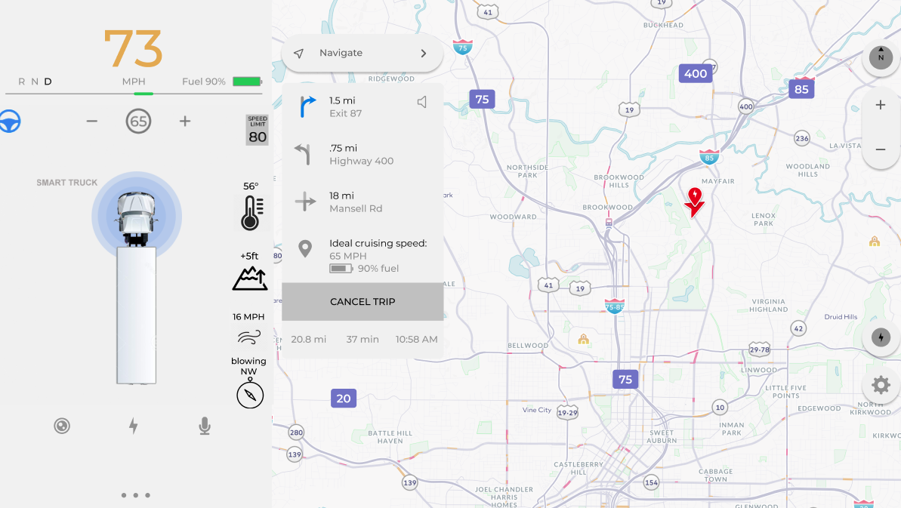
Interface prototype
Notes:
https://www.trucking.org/economics-and-industry-data#:~:text=Number%20of%20Trucks%3A,%2C%20up%201.5%25%20from%202019.
37.9 M trucks registered and used for business purposes (excluding government and farm) in 2019, representing 23.9% of all trucks registered.
45.6 billion gallons of fuel consumed by those trucks used for business purposed in 2019.
36.5 billion gallons of diesel fuel.
9.1 billion gallons of gasoline.

Slide 8
Optimizing for the ecosystem and the environment
Operational Costs | Contribution
Wages | 43%
Fuel | 24%
Insurance | 19%
Leasing/ Financing | 9%
Repairs & Maintenance | 5%
Total | 100%
Up to 50% profit margin improvement for carriers
4.5 billion gallons of diesel fuel saved
50 million tons reduction in CO2 emissions
Industry research indicates solution can save up to 10% of fuel costs
Industry profit margins at ~4%
Source: American Transportation Research Institute | NACFE’s 2017 Run On Less demonstration | Current Industry Margins @ 3.9%

Slide 9
Clear growth roadmap with established market
01
02
03
Phase 1
Phase 2
Phase 3
Long-haul trucks
Autonomous Fleets
Last-Mile Logistics

Slide 10
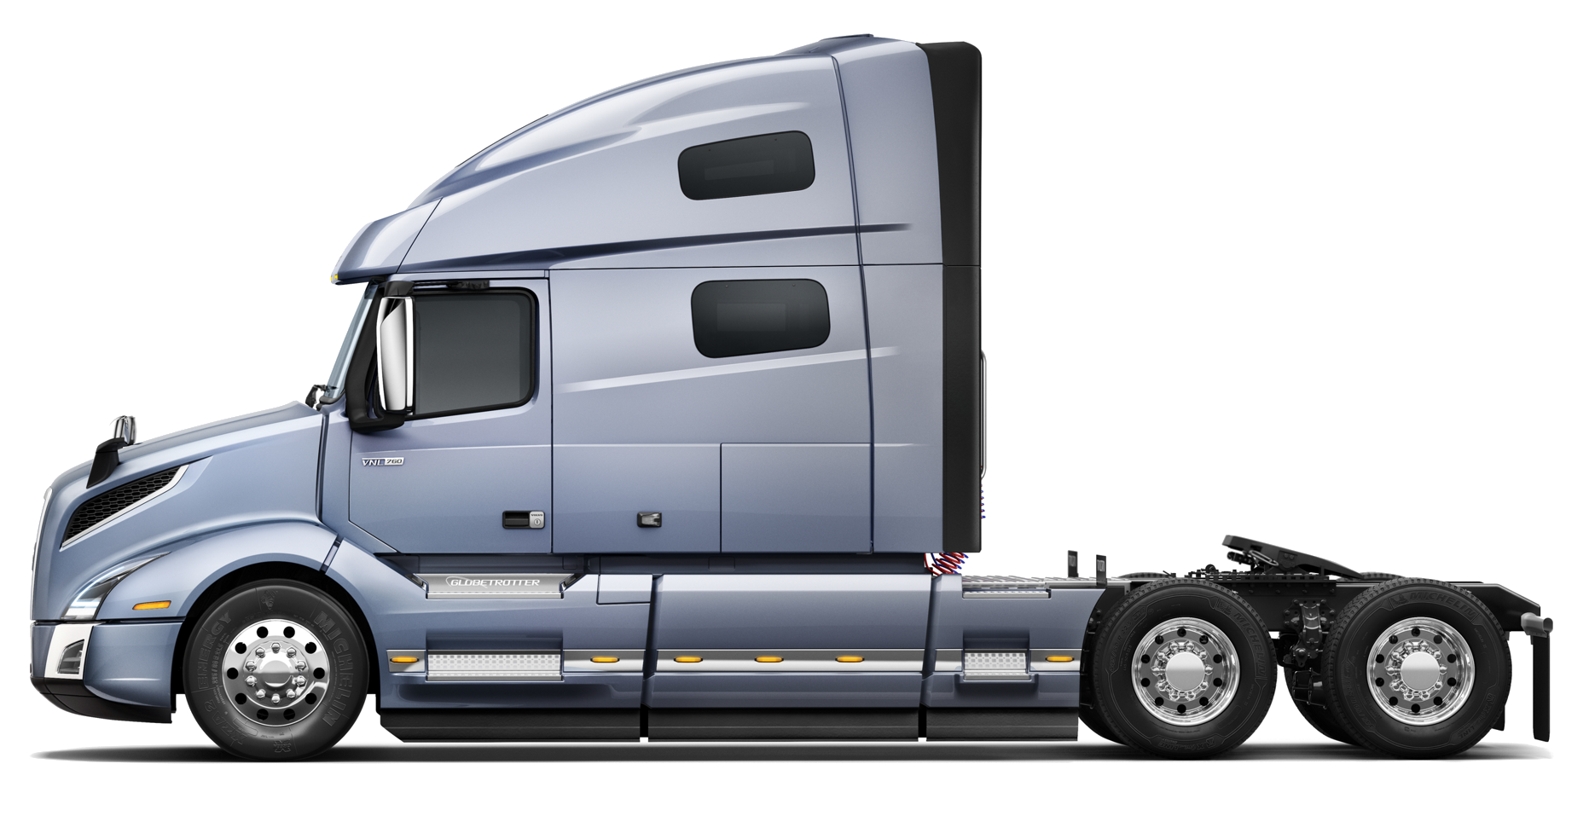
Targeted segment – Immediate addressable market
American Trucking Association’s data:
37.9 M trucks registered and used for business purposes in the US in 2019
3.97 M Class 8 trucks in operation in 2020
45.6 B gallons of fuel consumed
Notes:
https://www.trucking.org/economics-and-industry-data#:~:text=Number%20of%20Trucks%3A,%2C%20up%201.5%25%20from%202019.
37.9 M trucks registered and used for business purposes (excluding government and farm) in 2019, representing 23.9% of all trucks registered.
45.6 billion gallons of fuel consumed by those trucks used for business purposed in 2019.
36.5 billion gallons of diesel fuel.
9.1 billion gallons of gasoline.

Slide 11
We estimated a potential market size of $476 M in phase 1
19,500 GGE¹ (Annual fuel consumption of a class 8 truck)
Subscription plan of $120 per year
$7.3k - $10.4K of savings per year
~$476 M of market size
~48 M tons of CO2 emissions reduced
7% - 10% of fuel savings with Smart Drive⁺
12,270 ~ 17,330 tons of CO2 per truck
3.97M # of class 8 trucks
$5.34 / GGE²
With our strong value proposition, we expect to capture 8% of market in Year 1
(TAM: $38M)
(1): Gasoline Gallon Equivalents (2) Weighted average of regular gas and diesel
Notes:
https://www.trucking.org/economics-and-industry-data#:~:text=Number%20of%20Trucks%3A,%2C%20up%201.5%25%20from%202019.
37.9 M trucks registered and used for business purposes (excluding government and farm) in 2019, representing 23.9% of all trucks registered.
45.6 billion gallons of fuel consumed by those trucks used for business purposed in 2019.
36.5 billion gallons of diesel fuel.
9.1 billion gallons of gasoline.

Slide 12
Pricing Plan
Two business models
SAAS pricing for fleets
$120/year per truck
Compare with $7.3k - $10.4K in annual fuel savings per vehicle
Licensing for OEMs
Pricing TBD based on size of manufacturer
Ship by default or by option: allow placement of software on all new manufactured vehicles

Slide 13
THANK YOU
Q&A

